Slide 1

Research update aka:
“What i did with proteins since my summer vacation”
ProFET https://github.com/ddofer/ProFET
Dan Ofer

Slide 2

Topics
1) ProFET (Protein Feature Extraction Toolkit):
  From NeuroPID to ProFET: Classifying Proteins, (alignment free).
  Feature Engineering & Representation - for proteins
  ProFET Capabilities & Methods = Features, ML Tools (Feature selection, model tuning..)
  Results.
2) Future
  ProFET: a) Website. b) Application.
  BloSUM^2 : 400 X 400
  Local PTM Prediction + Deep learning
  Improved Amino Acid (Propensity) scales.

Slide 3
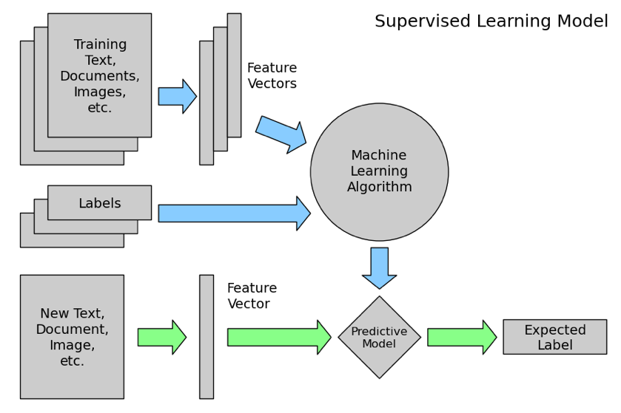

Machine Learning Workflow

Slide 4

Feature Engineering & Representation
The second HARDEST, most fundamental part of machine learning: Feature engineering = “Create good features”
  Domain specific
    “Fat Prediction”: BMI as a feature, Weight/Height ratio as a feature (vs just height and weight).
    Images: Find lines, boxes, convolutions over pixels, haar wavelets, histograms, etc’
    Audio: Time series transforms of sound (Fourier Transform, wavelets..), MFCC..
    LOCAL Protein properties (e.g. Protein STRUCTURE, Disorder,sites): Fixed size window, features can be Amino Acids at conserved position. More possible features (e.g. PSSM...).

Slide 5
Feature Engineering & Representation
The HARDEST most fundamental part of machine learning: Feature Representation = “What do we turn into features”?
  “What can we quantify?”
Usually we only ask this once (one answer) - then continue to Feature Engineering.
  Images: Raw pixels (RGB values).
  Audio: Input time series (recorded volume, frequency..)
  Proteins: The amino acids? Structure (2d? 3D? ??) ?
    Local protein properties: AA at each site.
    ENTIRE Protein sequences : ???.
        Example: Amino Acid Composition? 3D Structural fold?

Slide 6
Feature Engineering & Representation
  Remember - We need a fixed length feature vector!
  Many articles - keep reinventing the wheel for some features, and rewriting (bad) code.
  We want to get a good, universal answer for:
    1) How to represent proteins. (For ML “consumption”)
    2) A good set of “baseline” features for whole proteins (or peptides)!
Answer: ProFET (Protein Feature Extraction Toolkit)

Slide 7
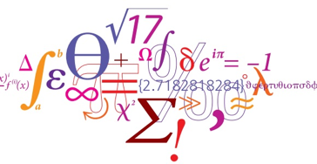
From NeuroPID to ProFET: Protein Feature Extraction Toolkit
Same approach as in NeuroPID:
  Extract global features from proteins (any length).
Features & approach are “universal” - So apply to more types of problem!
BONUS: Expand messy scripts into a larger, more powerful toolkit for extracting features from proteins.

Slide 8
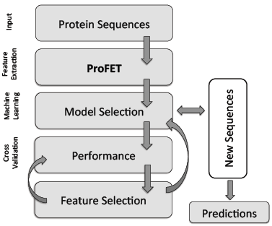
ProFET’s Modular Workflow
Get (Global) features from Protein sequences
  Can be analyzed independently (unsupervised) or comparatively (for classifying).
Model Selection:
  Automatically find best Machine Learning (ML) model(s) & hyperparameters for any metric (e.g. multi-class accuracy, Sensitivity for just one class..).
Performance Report: Cross-Validated Classification performance for any given model and dataset.
Feature Selection
  Many methods including: statistical significance, wrapper methods (RFE), model based selection, stability selection…
Predict new sequences
BONUS: Nice utility functions for loading/saving data, model selection, performance tuning, etc...

Slide 9
Benefits of global features
Don’t rely on searching external databases, homologs or alignments (unlike BLAST, PSSM, HMMs, Structural prediction, PFAM..).
Fast to extract and compute.
Universal. (Present and extractable from any protein/peptides)
Many more could be added. (Limit was time). Notably - Time series decomposition (Wavelets), and externally predicted features (SignalP, TMD..).
I collected + implemented many “State of the art” features. (E.G alphabets, AA Scales..)
Very convenient for state of art machine learning methods! (As opposed to HMMs, BLAST distance matrix+SVM..).
All the features are customizable!

Slide 10
Global features - Examples:
(A) Biophysical quantitative properties.
  Weight.
  Length.
  Net Charge. (At various PHs).
  GRAVY (Grand Average of Hydropathy)
  Relative side chain volume (aliphaticness; aromaticity)..

Slide 11
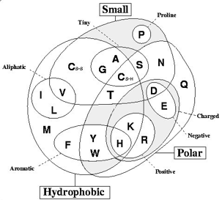
Global features - Examples:
(B) “Letter” based features.
  K-mers. (k=2; alph = 0,1 -> [01,10,11,00])
    “Mirror” K-mers. (01 == 10 ). {13^2 =169 -> 98}
  Amino acid composition (K=1).
  Reduced amino acid alphabets.
    (“I,L” == “I”).

Slide 12
global features - Examples:
(C) Local potentials:
  i. Potential PTM motifs.
      e.g. Glycosylation, KR-cleavage..
  ii. Potential Disorder (FoldIndex ; TDP-IDP).
(D) Information theory statistics:
  Entropy.
      (Per letter and per sequence)
  (Binary) Autocorrelation.
      ([K,R] = 1, all others = 0)

Slide 13
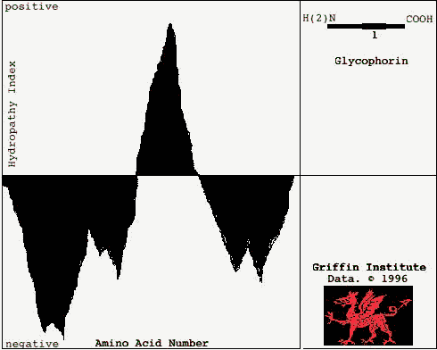
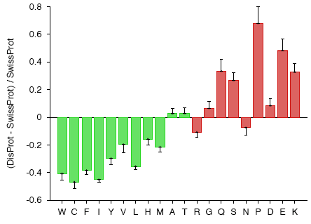
Global features - Examples:
(E) AA scales based features
Amino acid propensity scales map each amino acid to a quantitative value that represents a property propensity, such as hydropathicity or size.
  eg: Disorder:

Slide 14
Global features - Examples:
(F) C, T, D features (3 letter AA reduced alphabets)
    i. C - Composition.
    ii. T - Transitions.
    iii. D - Distribution.
        (% of AA in first 25% of sequence, etc’ ).
(G) Subsequence features
  i. Relative subsequence portions.
      Divide into 3: Get features for each third
  ii. Fixed subsequence lengths.
      “Features for first 27 aa in sequence” (N-tail), and last 24 (C-tail)

Slide 15
Model Tuning
VERY Important in ML!
    (Less so for Random Forests)
Many models supported; (only some tested).
    “Model selection” pipeline can easily be expanded to integrate wider hyperparameter search, feature selection, PCA, model stacking, etc’.
    Overall best: SVM + RBF (Gaussian kernel), Random Forests.
Supports multiclass, imbalanced classes, any metric..

Slide 16
Feature Selection (FS)
General note: Always apply FS as PART of your CV splits, not in advance! (Data sanitization).
Lots of methods available for analyzing “post-hoc”.
Personal favorite pipeline: (1-2 or 1-2-3)
  1. Statistical significance. (ANOVA : F-Test; 0.01).
  2. L1 filter - SVM or “Stability Selection” (Randomized Logistic regression bagging ensemble). - Filters further, removes duplicate/correlated/redundant features.
  3. Wrapper method Random Feature Elimination (RFE)
    My own invention: RFE-RF. (RFE with Random Forests).
    RFE: Train model on data -> get model coefficients (= feature importance) -> Remove x% “weakest” features -> Retrain iteratively with remaining features.

Slide 17
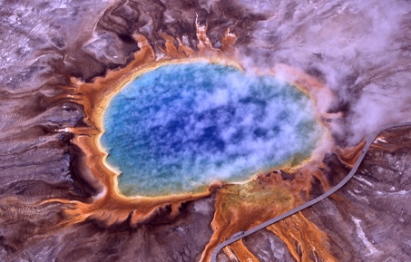
Datasets (1): Thermophiles & Neuropeptide precursors (NP)
1. Literature Dataset [915] Thermophile Proteins vs [793] non thermophiles (Mesophiles).
  Extra filter: Max 40% Id.
2. Neuropeptides (NP) [1,269] vs Non neuropeptides [2,309].
    TOUGH negative set - All must have Signal peptide, no Transmembrane domain, similar lengths to NP. (10% Id filter).

Slide 18
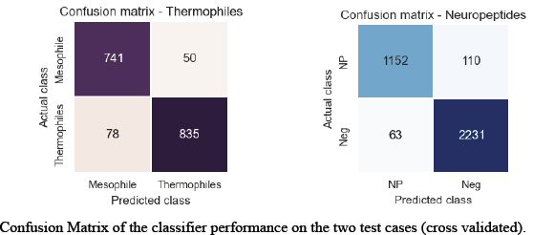
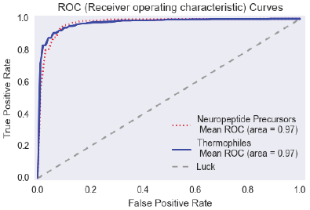
Thermophiles & NP Results
State of the art performance
F1 scores:
  Thermophiles = 90.6%
  NP = 94.5%
ROC-AUC (Area under curve) = 97%
Some nice output figures..

Slide 19
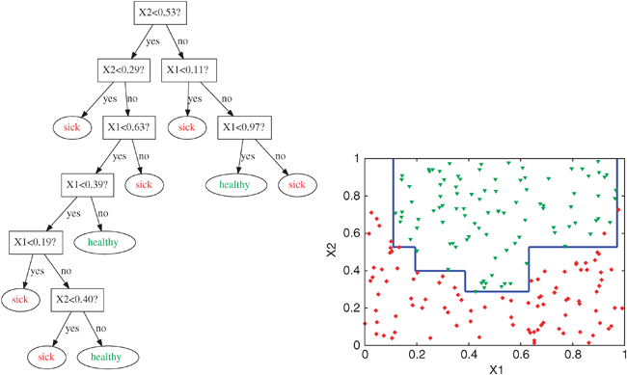
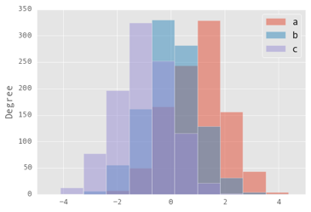
Python + Pandas + Clean Data = Easy to make more figures, Data Visualizations..
  E.g. Histograms of properties per class, Classifier decision surface, Decision tree graph…

Slide 20
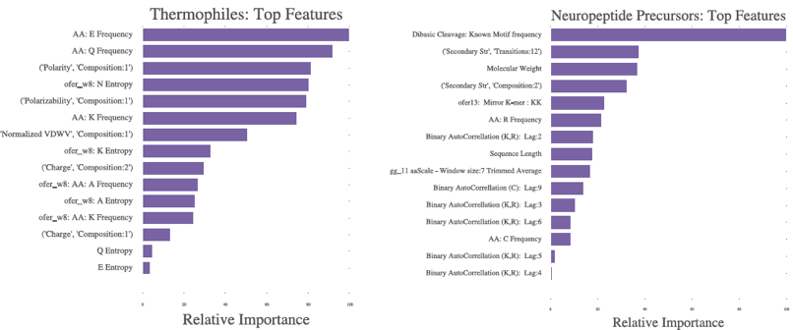
Feature Selection
Feature filter of 0.01 (F-test), {771 -> 661 features} followed by RFE-RF [On whole data :( ] for top 15 features; (Then Ranked by classifier) :
Performance was still ~95-99% of max.

Slide 21
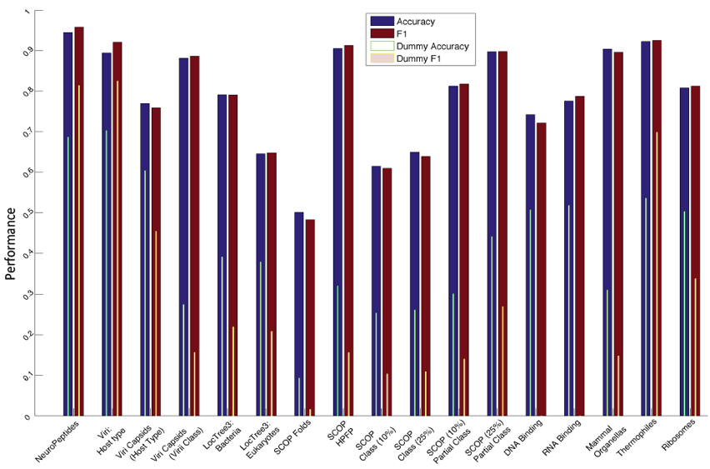
Datasets (ii): Lots

Slide 22
ProFET: Recap
Framework, Pipeline and Modular resource for extracting protein sequence features for Machine learning.
Easy to use or customize new biologically relevant features.
Excellent performance.
Suited for “high level” problems. (Won’t replace BLAST anytime soon).
“Hammer in search of nails”:
  There are MANY articles in the style of: “[Insert protein class/type here] discovery using [Insert trendy ML model here - usually SVM/RF/”Deep learning”] ± using [Insert Feature selection technique here - usually mRMR, SVM-L1 or RFE]”
  ProFET workflow makes this as easy as “point and click”, given a set of fastas.
    Utility scripts also help in loading multifasta formats used in some literature benchmark datasets.

Slide 23
Future: ProFET
1) Lots of room for expansion:
  More Features: Time-series decompositions, Pseudo-AA composition, list of PTM motifs (ELM, PRINTS)...
  Multi-Label classification. (Supported by underlying ML algorithms. Just requires modifying “utility” scripts).
  Better code! (Readability, Python module, performance).
2) Website.
  Focus on Feature selection and comparison to backgrounds (“Composition profiler” style).
3) Integration into NeuroPID - NPID 2.0. (Improved features, classification framework and tougher dataset).
Any nice set of interesting proteins - are a potential target! (Feel free to suggest!)

Slide 24
Future: More
1) BloSUM^2 : 400 X 400 amino acid substitution matrix.
Substitution matrix between PAIRS of AA, instead of single AA.
  Get MSA from PFAM, HSSP (3d structure MSAs based on PDB), ecod..?
  Get ungapped local alignments. Why?
Q: How to measure performance? A: Test alignments on proteins of known 3d Structure.
Q: Problem: How to Align? (Needleman-Wunsch.). ?
  Ideas?
2) Local PTM Prediction
3) Improved Amino Acid (Propensity) scales.

